Slide 1
IBM Data Science Capstone
Brianna Shannon
Dec. 2020

Slide 2
Background
Rome is the second tourist city in all of Europe
It’s packed with history as since it was founded in 735 BC
Ancient Rome was built on the 7 hills and fairly spread out
Because of this, tourist attractions are spread out too

Slide 3
Problem
Tourists are not optimizing their visit because they spend a lot of time traveling between attractions
A k-means model could cluster attractions by location to help optimize planning and reduce travel time between attractions

Slide 4
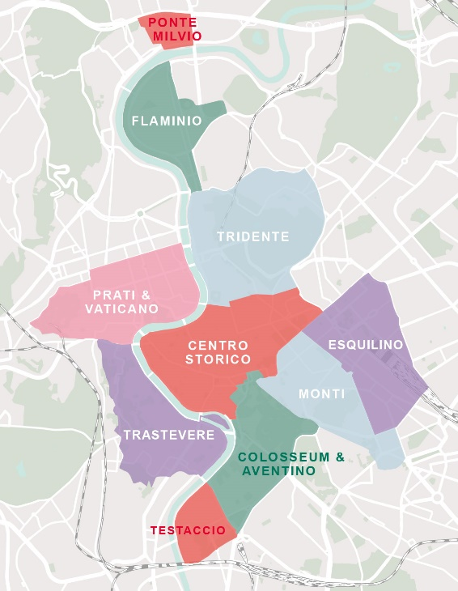
Data Acquisition
Subdivision of Rome were acquired from https://www.timetomomo.com/en/destination/rome/
Coordinates for these subdivisions were pulled from google maps
Attractions were pulled using an API for Foursquare

Slide 5
Data Cleaning
Because Foursquare has more than just tourist attractions, so venues will need to be remove
Like venues were lumped into the following categories
Fast Food
Food
Dessert
Alcohol
Outdoors
Museum
Store
Religious Site
Art

Slide 6
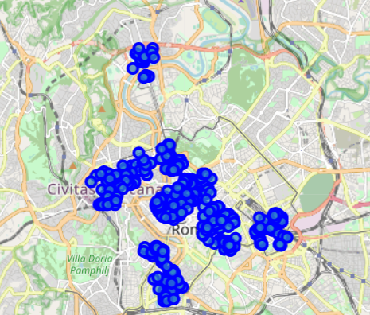
Unclustered Venue Map

Slide 7
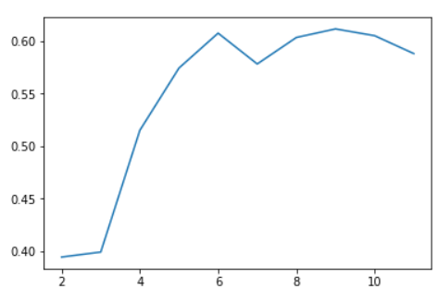
Silhouette Score
Silhouette Score was used to find the optimal k value for K-Means Clustering
Since there were 11 subdivisions, the maximum k value is 11
Based on the results, a k value of 9 was selected

Slide 8
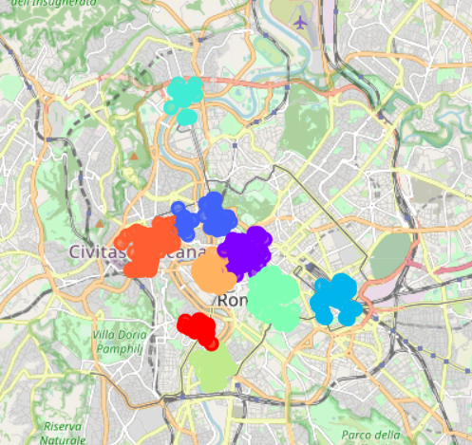
K-Means Clustering
The model was ran using a k value of 9 and clustered based on location

Slide 9
Conclusion
Built useful model to cluster tourist attraction in Rome
This can be used to better plan a visit to help reduce wasted travel time between sites

